Slide 1
Establishing a SQL database to manage customer data (Olist)
Olist store

Slide 2
Presented by:
Mohaimen
Amer Ahmed Ismail
Ahmed Eltaweel
Mohamed Fadel
Mahdi
Mourad Hany Abdelaziem

Slide 3
Objectives
Design a SQL database schema for customer data management
Implement the database using Microsoft SQL Server
Develop SQL queries for data extraction and analysis

Slide 4

SQL Database
Data Warehouse
1
2
built an operational database shcema.
bulk inserted the csv data into the warehouse into staging temp tables
Database
Data Warehouse
3
4
performed an etl to move the data to the staging/devolopemnt warehouse locally
performed data cleaning before populating the database
Azure
5
modeled a snow flake schema warehouse for orders analysis at the order item granularity level

Slide 5
Database Design
Schema Overview
Tables to Include
TempGeolocation:
TempCustomers:
TempOrders:
TempPayments:
TempReviews:
TempProducts:
TempSellers:
TempOrderItems:
TempProductTranslations

Slide 6
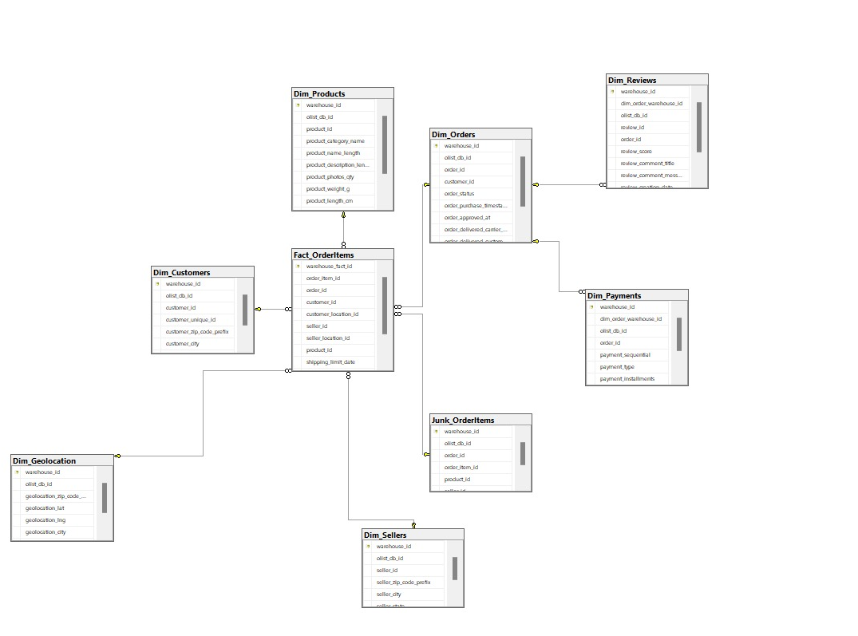
Relationships

Slide 7
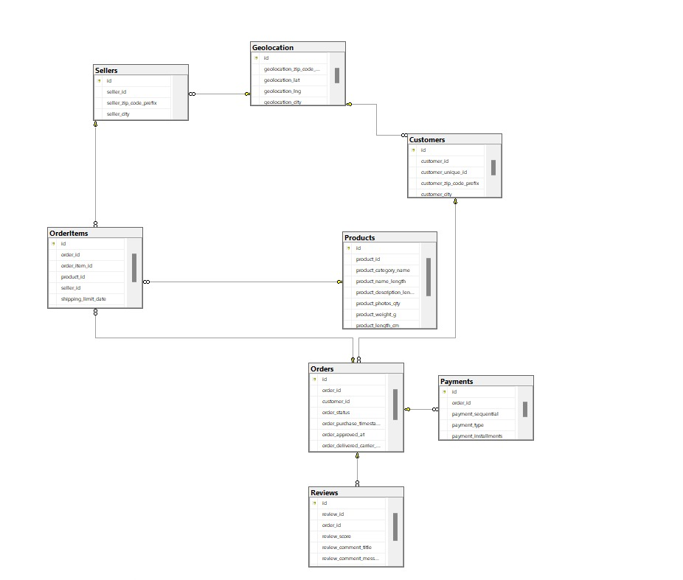
Relationships

Slide 8
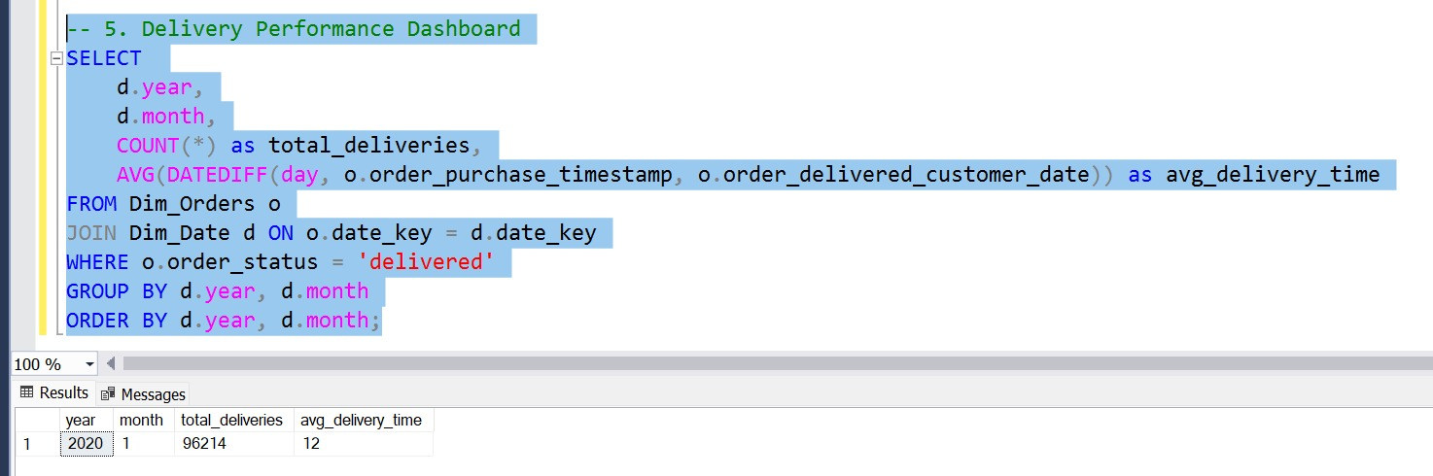
Data analysis

Slide 9
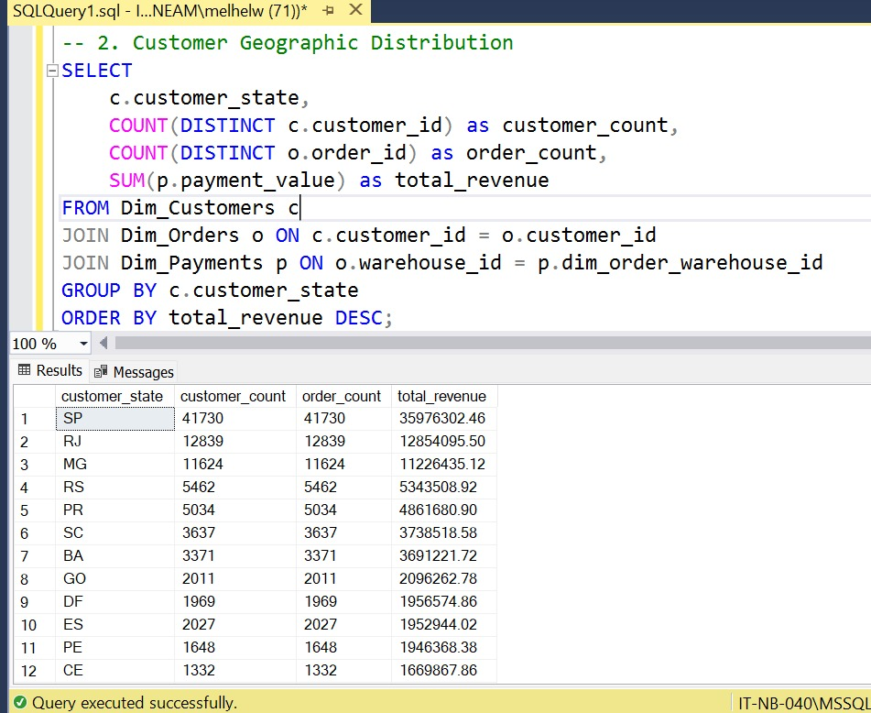
Data analysis

Slide 10
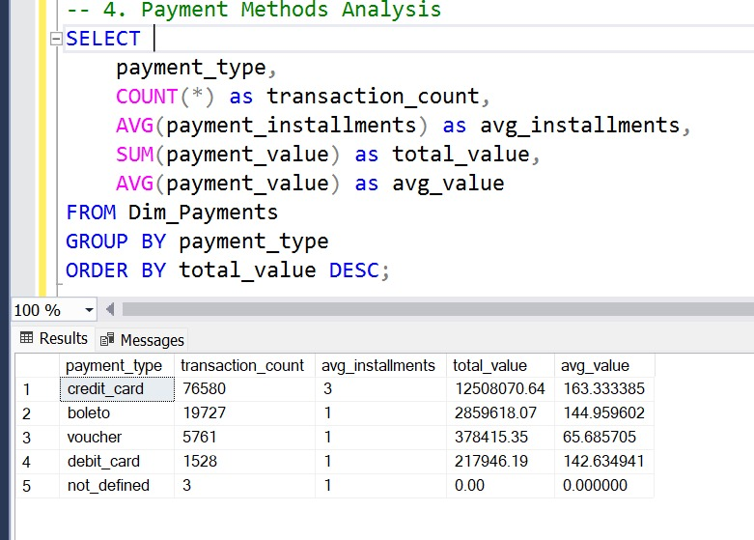
Data analysis

Slide 11
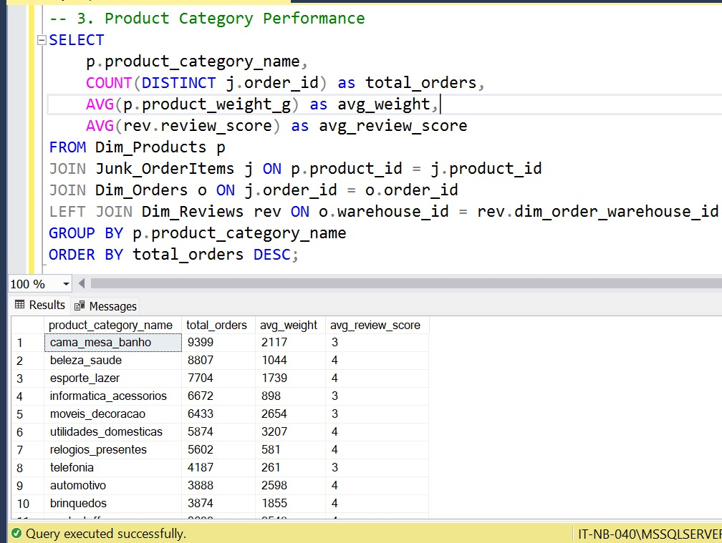
Data analysis

Slide 12
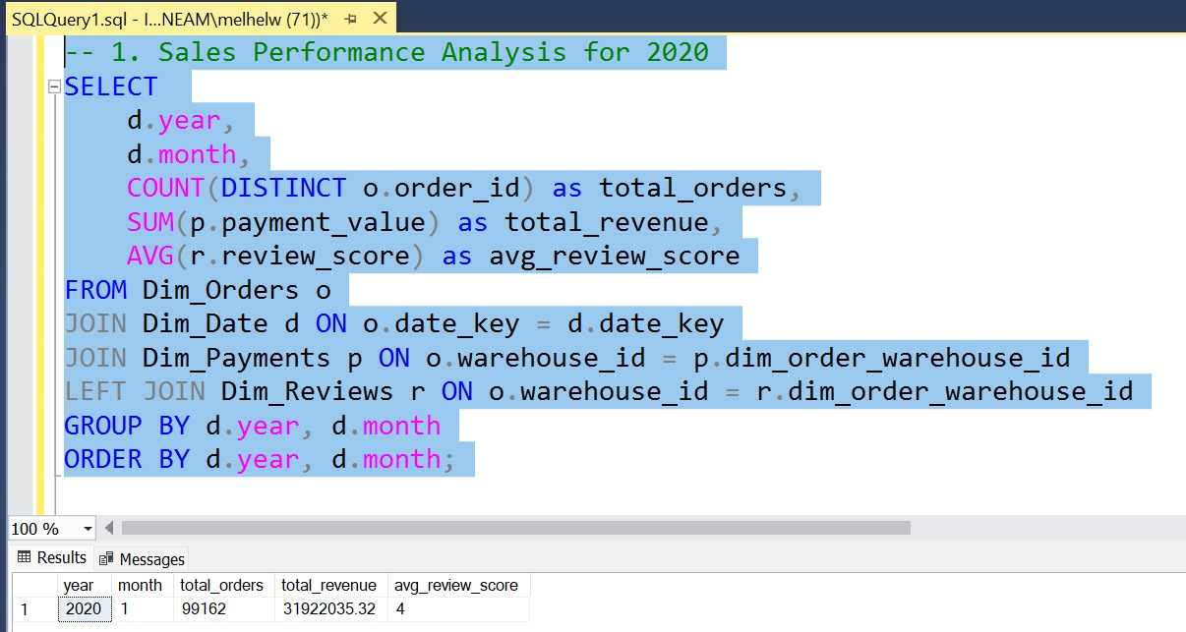
Data analysis

Slide 13
Implementation Steps
Set Up Environment
Install Microsoft SQL Server and SQL Server Management Studio (SSMS)
Create Database
Use SQL commands to create a new database
Define Tables
Write SQL scripts to create the necessary tables according to the schema design
Populate Database
Insert sample data into each table for testing purposes

Slide 14
Key Queries to Develop
Key Queries to Develop
Data Extraction:
Retrieve all customer information
List all transactions for a specific customer
Summarize total transactions per customer
Data Update:
Update customer contact information
Modify transaction details if needed
Data Analysis:
Analyze trends in customer transactions over time
Identify the most frequent customer interactions

Slide 15
Tools Used
Microsoft SQL Server: For database creation and management
SQL Server Management Studio (SSMS): For writing and executing SQL queries

Slide 16
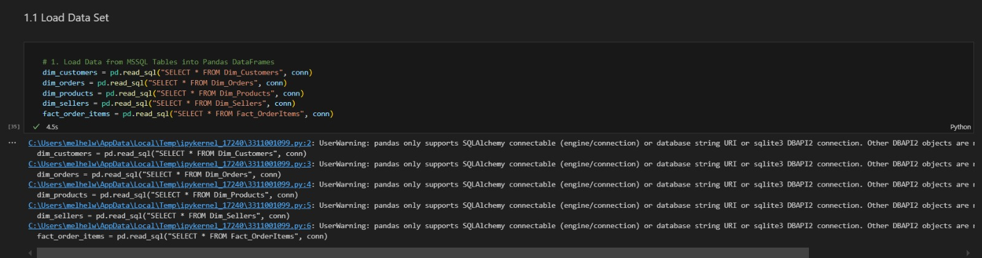

Slide 17
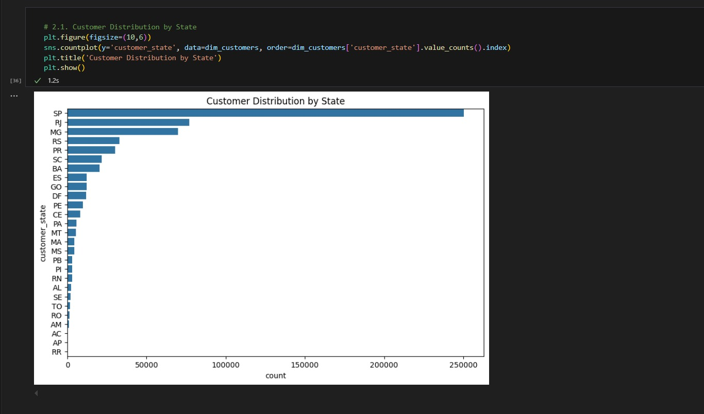

Slide 18
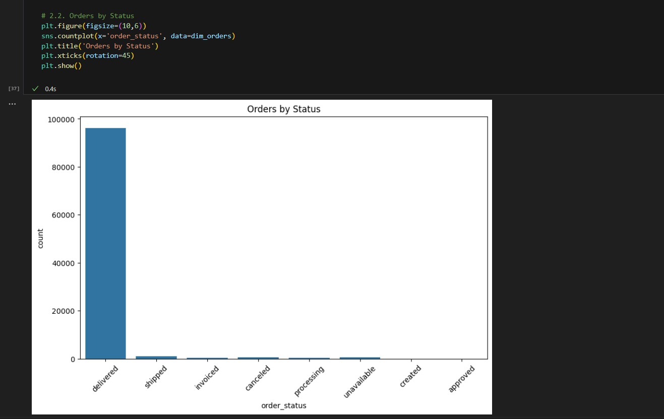

Slide 19
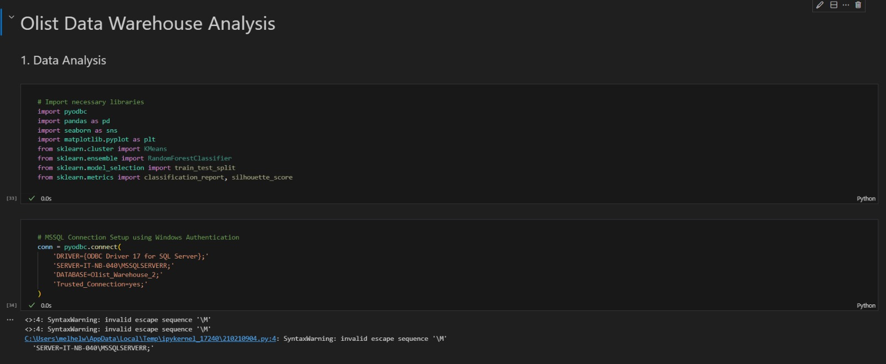

Slide 20


